Slide 1
Analysis and Model to Predict Future Housing Price of Toronto Neighborhoods
By:
Ali Abolhassani
Yuanyuan Zai (Grace)
Fernanda O’Malley
Muhammad Abuzar Butt

Slide 2
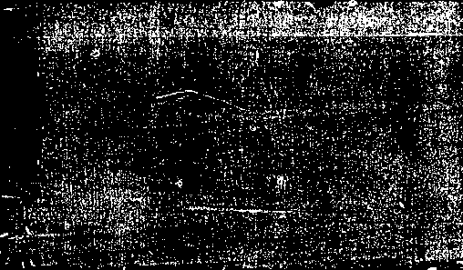
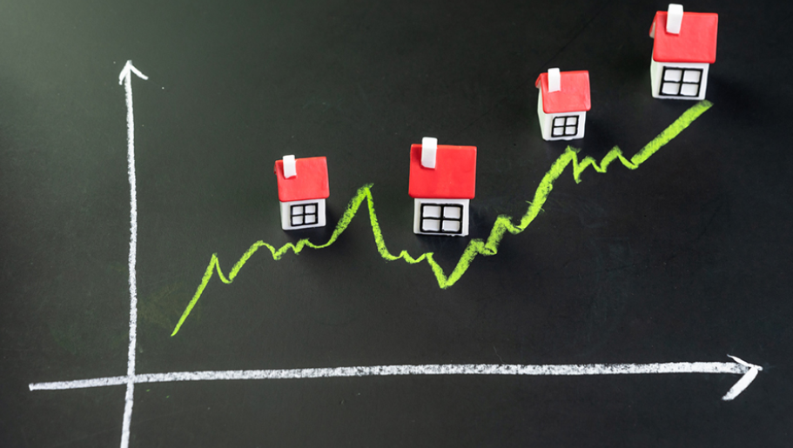

The Questions we will answer…
Key macro factors and their impacts - Grace
The most expensive neighborhoods in Toronto - Ali
The highest growth rate - Ali
The most affordable neighborhoods in Toronto - Fernanda
The prediction of the future housing pricing - Muhammad

Slide 3
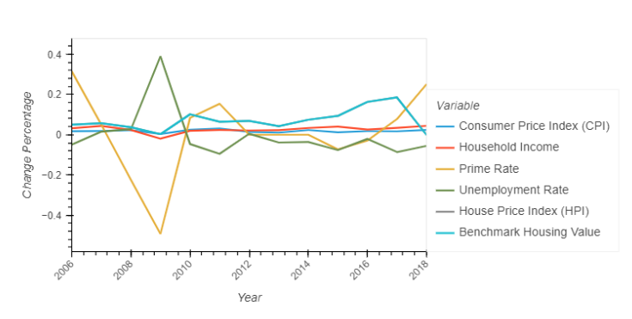
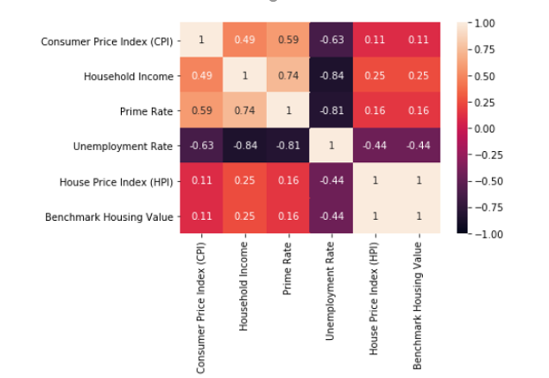
Macro Variables Analysis Housing market as one part of the economy will be influenced by macroeconomic factors. Key factors are Consumer Price Index (CPI), Unemployment, Household income, Prime rate, etc. Data source – Open Government (https://open.canada.ca/en)

Slide 4
Macro Variables Analysis - Findings
Unemployment rate has significant negative impact on the housing price.
Household income has slightly negative impact on the housing price.
Interest finding: Primary rate - Mainly negative impact - Exception: Period between 2008 and 2010

Slide 5
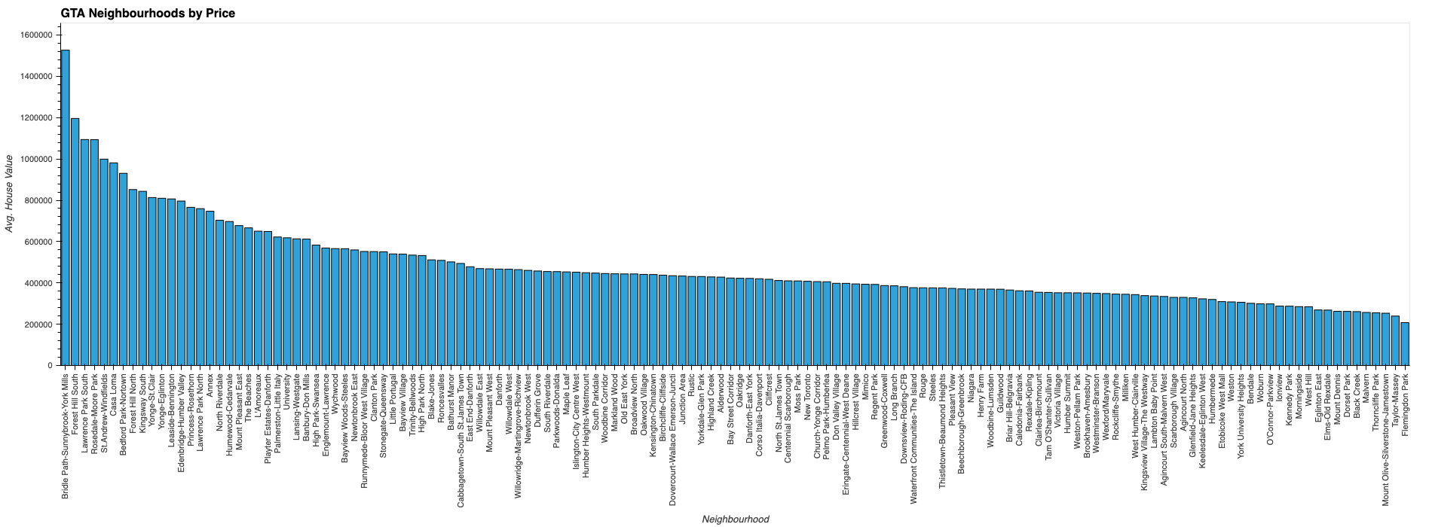
Most Expensive Neighborhoods Analysis

Slide 6
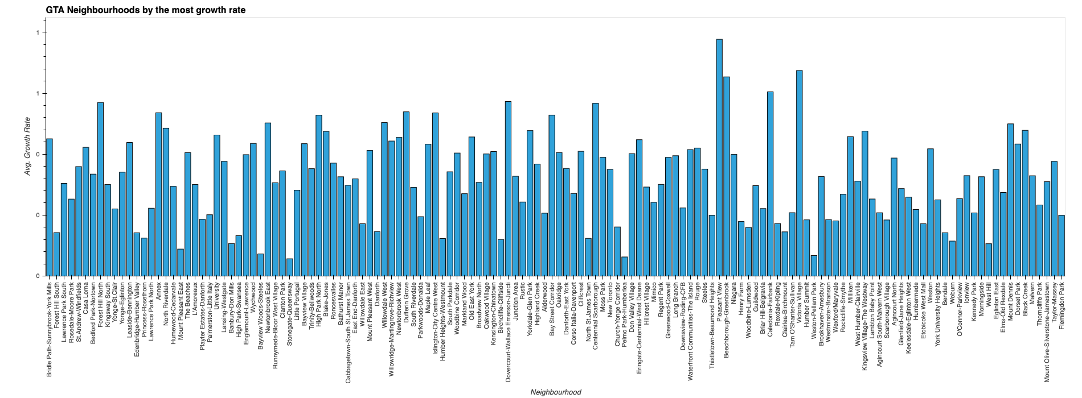
GTA Neighborhood by the most growth rate

Slide 7
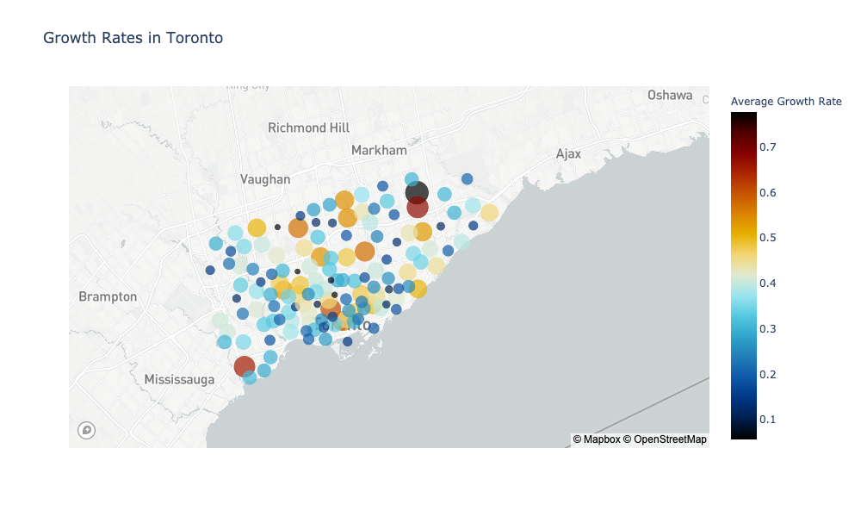

Slide 8
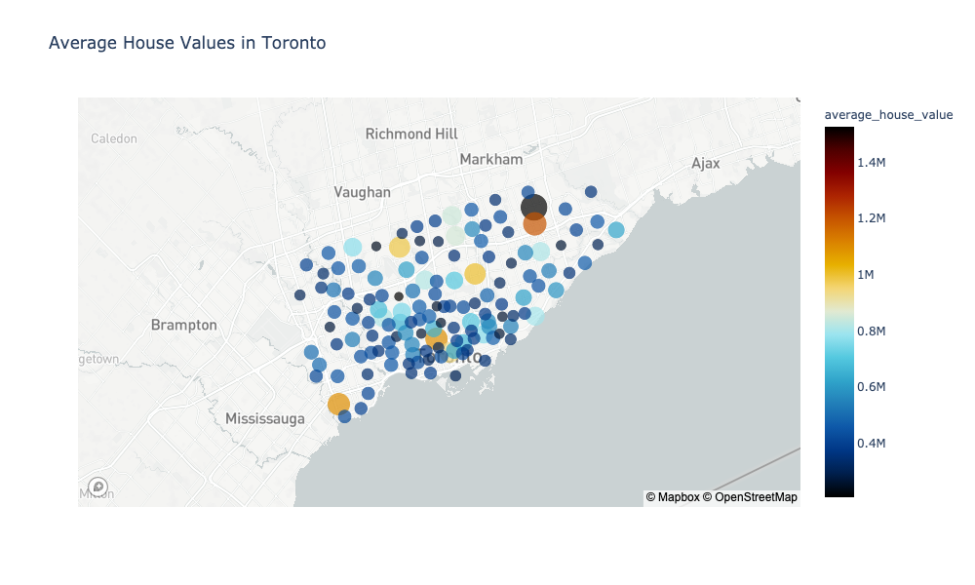

Slide 9
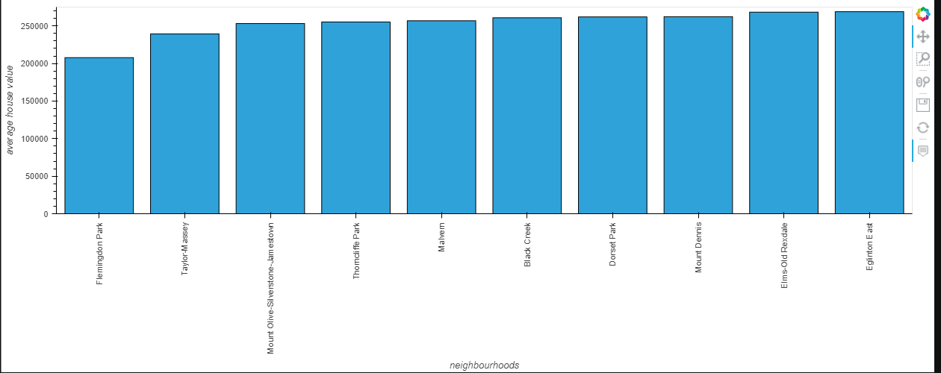
Cheapest Neighborhoods Considering houses prices

Slide 10
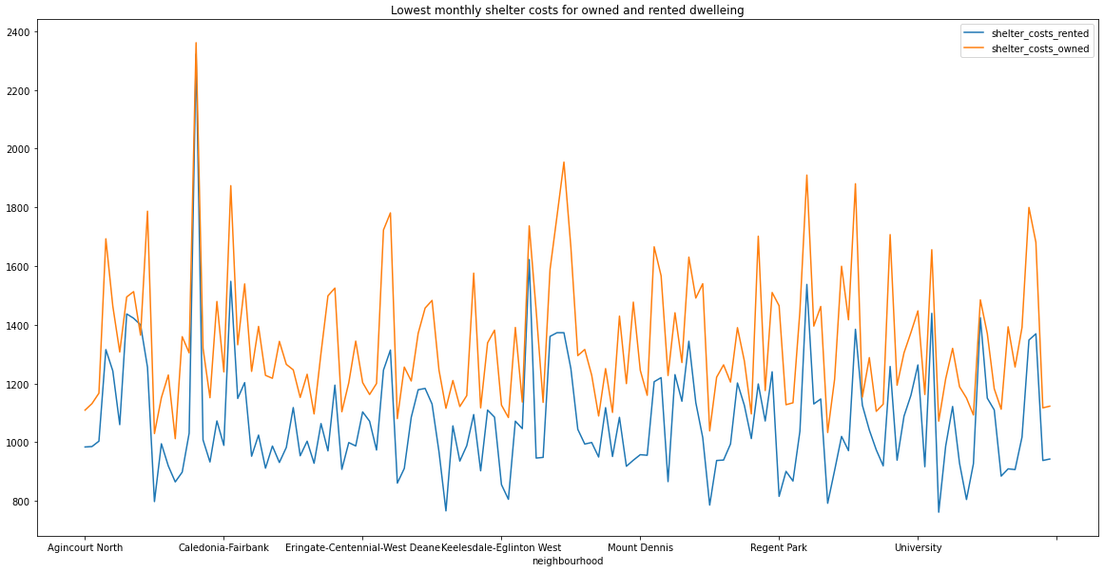
Cheapest Neighborhoods Considering Shelter costs (rented and owned), Rent, mortgage , interest, insurances , condominium fees, etc …..

Slide 11
Model to Predict Future Prices of Toronto Neighborhood
Cluster based analysis – K-means clustering is one of the simplest and popular unsupervised machine learning algorithms. In other words, the K-means algorithm identifies k number of centroids, and then allocates every data point to the nearest cluster, while keeping the centroids as small as possible

Slide 12
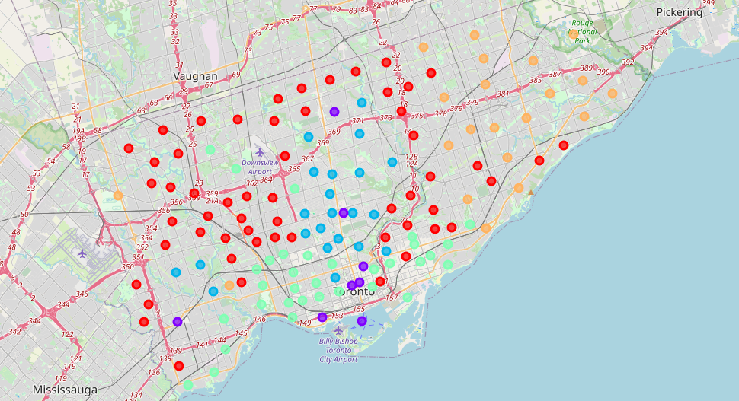

Slide 13
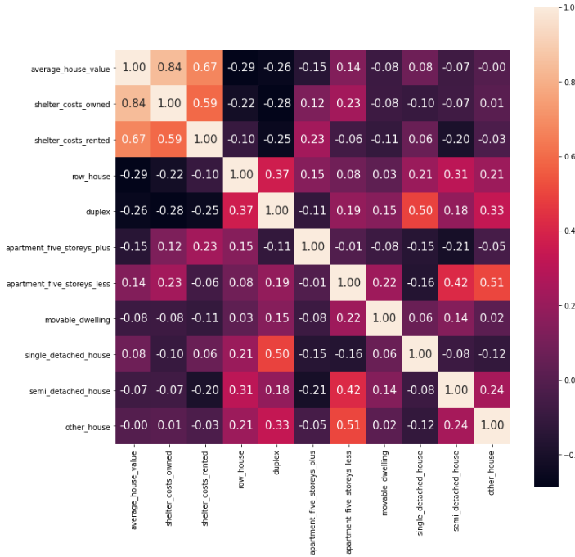
Seaborn plot on the correlation between different variables

Slide 14
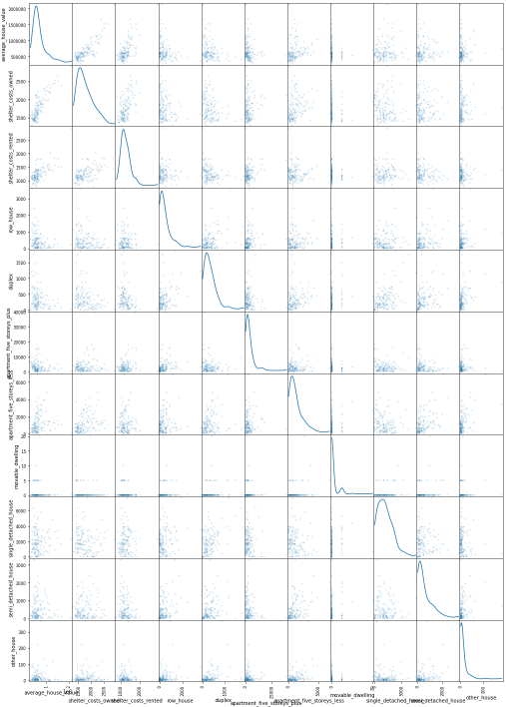
Plot Scatter matrix of correlation matrix of different variables

Slide 15
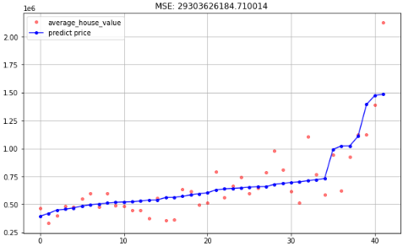
Price Predictability using Random Forest Regressor

Slide 16
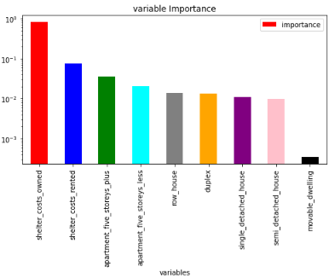
Importance Matrix based on different variables taken to predict price

Slide 17
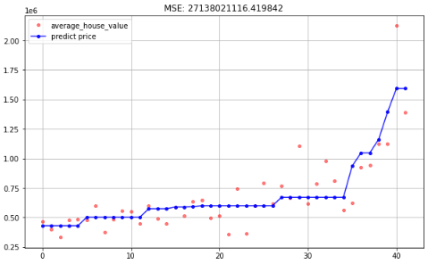
Price Predictability using Decision tree Regression Machine Learning Methodology

Slide 18
Conclusion
Based on the analysis above using the machine learning methodology, it is proven that the price of the Toronto market is going up steadily.
The impact is somewhat distorted due to may be inaccurate data, which proves that further cleanup is required.
The analysis could be further confirmed if more variables were available but due to time shortage we have to work with what was available.
Certain programs can be built to fetch data using web scrapping or API like 'foursquare API' to get neighborhood information like scores of different activities surrounding the neighborhood, to get better predictability.
But overall the above proves that Toronto market is going up but at a steady rate.

